Slide 1
Python –Tkinter And SQLite

Slide 2
Python (GUI)
Python offers multiple options for developing GUI (Graphical User Interface). Out of all the GUI methods, tkinter is the most commonly used method. It is a standard Python interface to the Tk GUI toolkit shipped with Python. Python with tkinter is the fastest and easiest way to create the GUI applications. Creating a GUI using tkinter is an easy task. To create a tkinter app:
Importing the module – tkinter
Create the main window (container)
Add any number of widgets (elements of GUI) to the main window
Apply the event Trigger on the widgets.

Slide 3
Python (GUI)
There are two main methods which needs to create the Python application with GUI.
1. ‘Tk(className=’Tk’)’.
To change the name of the window: change the className.
The basic code used to create the main window is: m=tkinter.
Tk() where m is the name of the main window object.
mainloop(): There is a method known by the name mainloop().
mainloop() is an infinite loop used to run the application, wait for an event to occur and
process the event as long as the window is not (closed.m.mainloop())

Slide 4
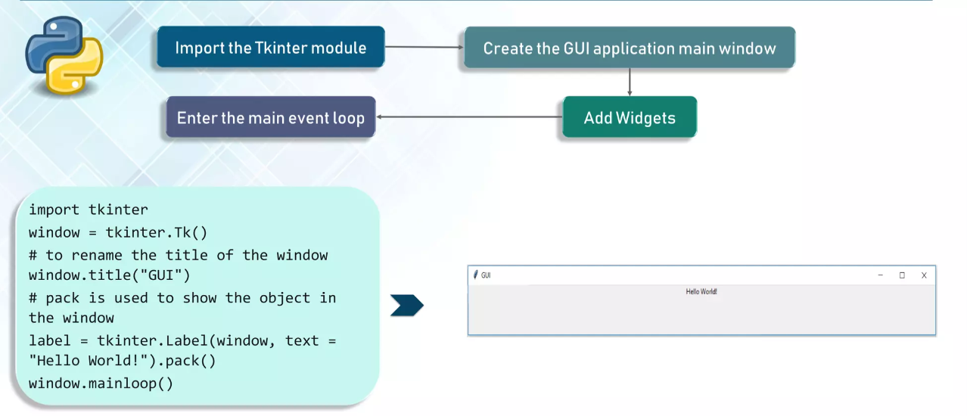
Python (GUI): Example

Slide 5
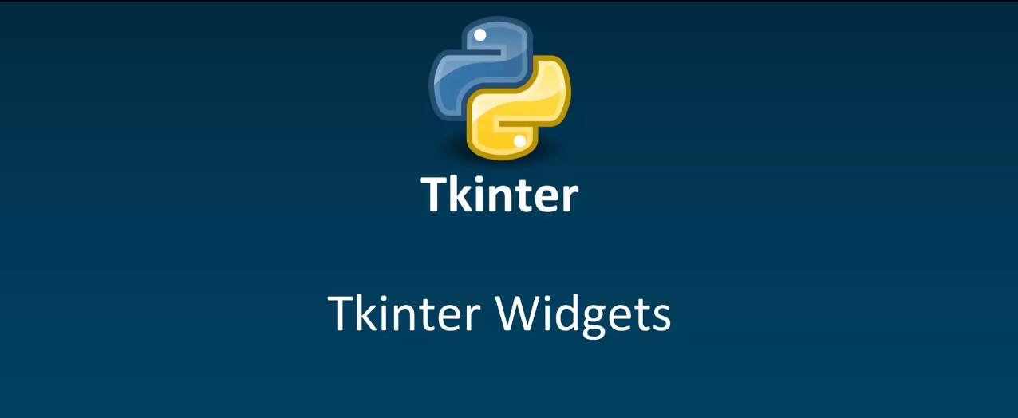

Slide 6

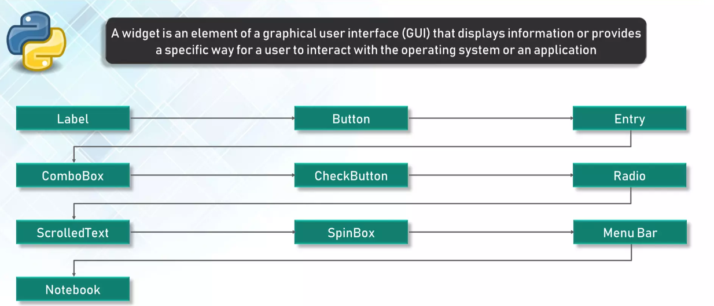

Slide 7
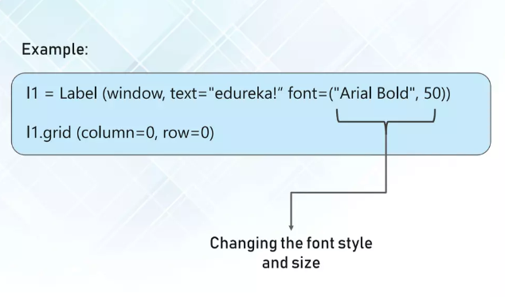
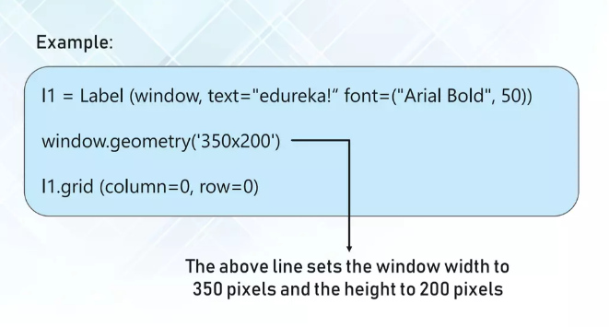
Label

Slide 8
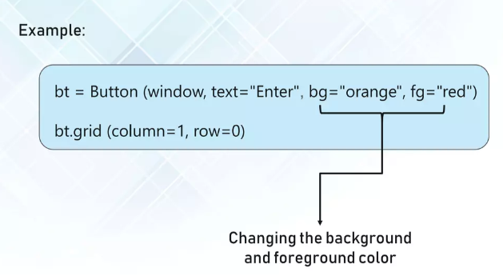
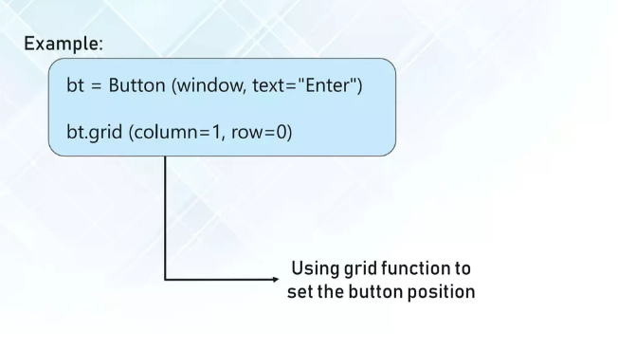
Button
import tkinter as tk
r = tk.Tk()
r.title(‘frame1')
button = tk.Button(r, text=‘exit', width=25, command=r.destroy)
button.pack()
r.mainloop()

Slide 9
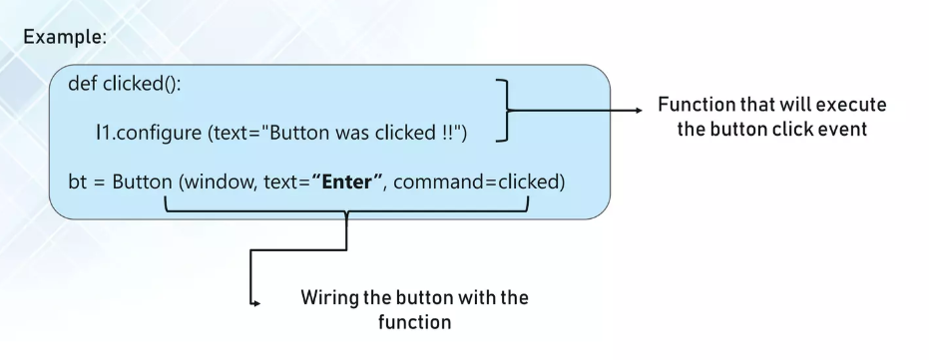
Button Function

Slide 10

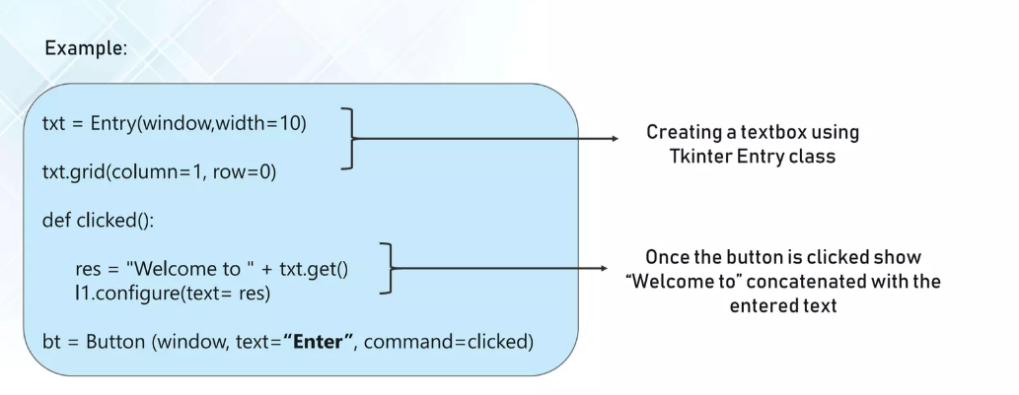
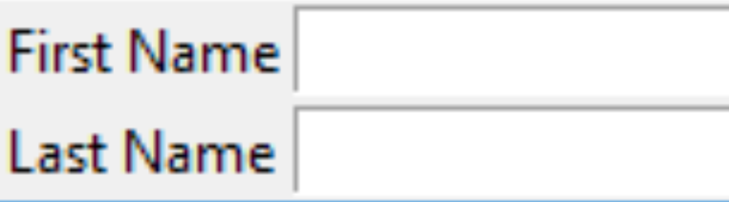
Entry
from tkinter import *
master = Tk()
Label(master, text='First Name').grid(row=0)
Label(master, text='Last Name').grid(row=1)
e1 = Entry(master)
e2 = Entry(master)
e1.grid(row=0, column=1)
e2.grid(row=1, column=1)
mainloop()

Slide 11
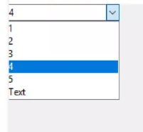
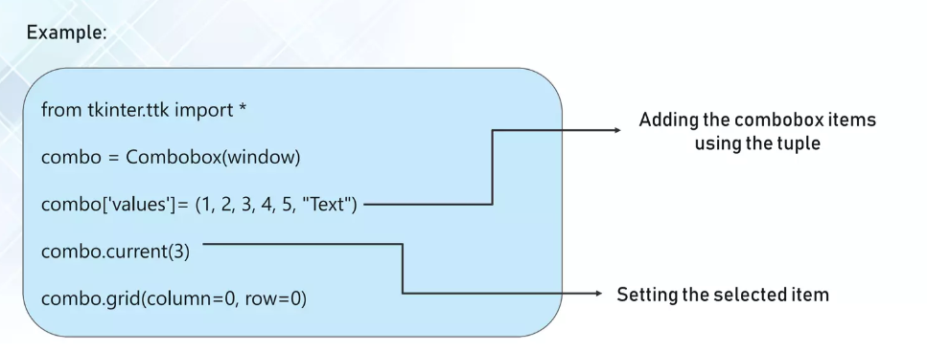
Combobox

Slide 12

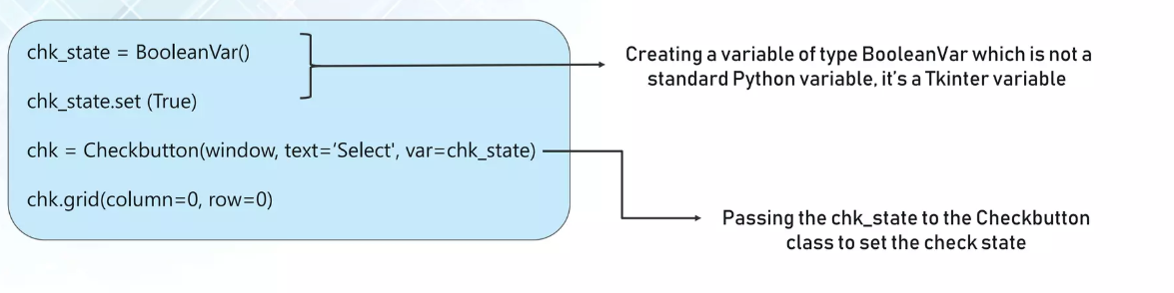
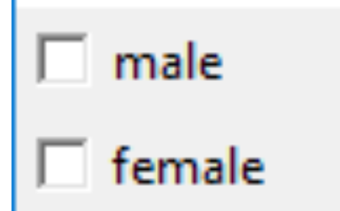
Checkbutton
from tkinter import *
master = Tk()
var1 = IntVar()
Checkbutton(master, text='male', variable=var1).grid(row=0, sticky=W)
var2 = IntVar()
Checkbutton(master, text='female', variable=var2).grid(row=1, sticky=W)
mainloop()

Slide 13

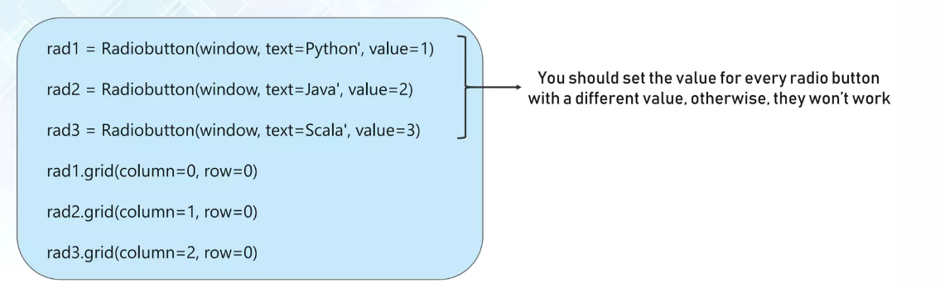
Radiobutton

Slide 14
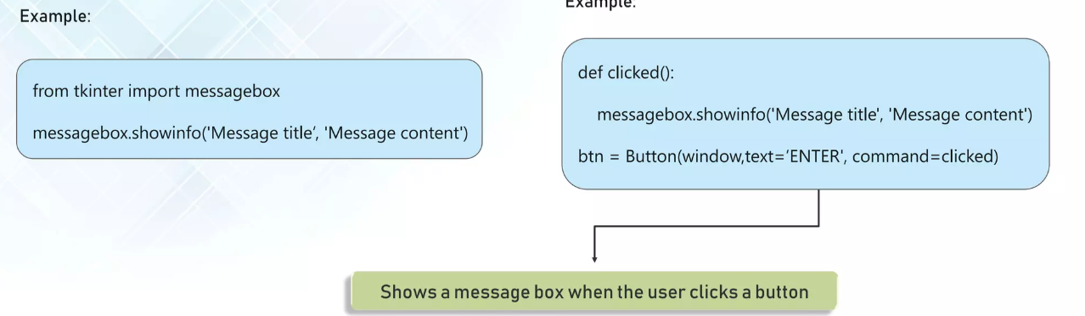
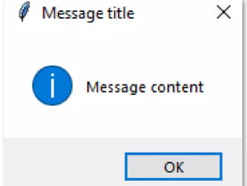
MessageBox

Slide 15


Slide 16
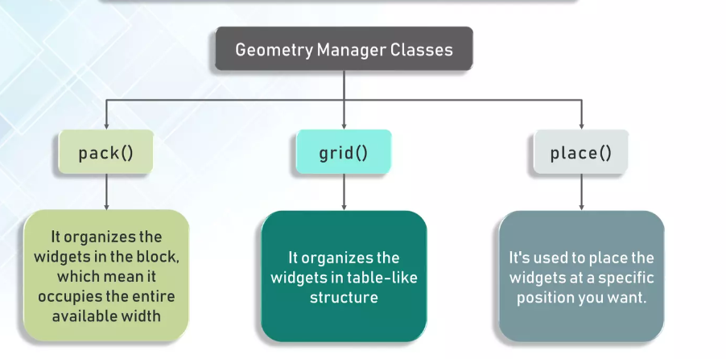
Tkinter – Geometry Class

Slide 17
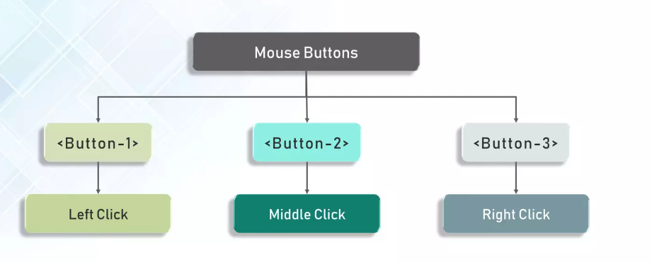
Mouse events

Slide 18
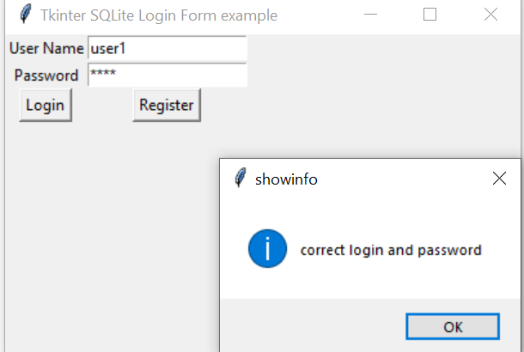
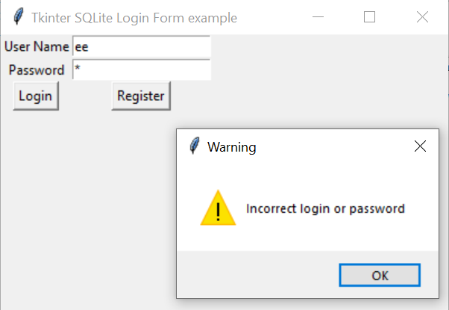
Example: Python - SQLite: Login and password check (Validation)

Slide 19
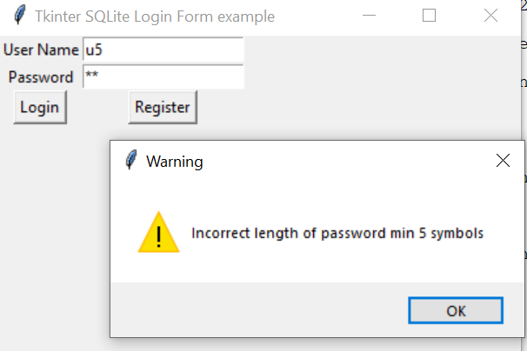
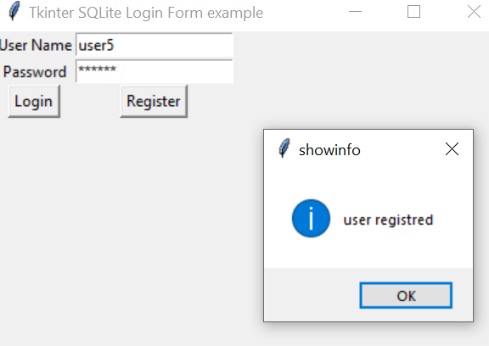
Example 2: Python - SQLite: check the verification of Login details and register customer

Slide 20
Tkinter: Creating window application
from tkinter import *
from tkinter import messagebox
from functools import partial
import sqlite3
# Window
tkWindow = Tk()
tkWindow.geometry('400x250')
tkWindow.title('Tkinter SQLite Login Form example ')

Slide 21
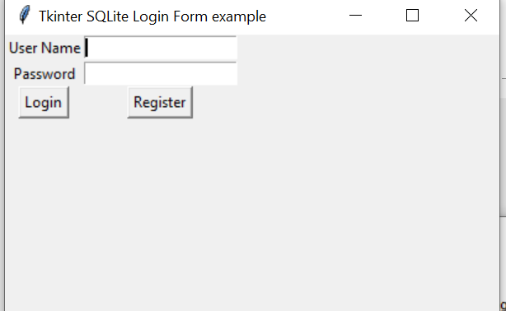
Adding Entry and Button
# Username label and text entry box
usernameLabel = Label(tkWindow, text="User Name").grid(row=0, column=0)
username = StringVar()
usernameEntry = Entry(tkWindow, textvariable=username).grid(row=0, column=1)
# Password label and password entry box
passwordLabel = Label(tkWindow,text="Password").grid(row=1, column=0)
password = StringVar()
passwordEntry = Entry(tkWindow, textvariable=password, show='*').grid(row=1, column=1)
validateLogin = partial(validateLogin, username, password)
# Login button
loginButton1 = Button(tkWindow, text="Login", command=validateLogin).grid(row=3, column=0)
register_customer = partial(register_customer, username, password)
#register
loginButton2 = Button(tkWindow, text="Register", command=register_customer).grid(row=3, column=1)

Slide 22
Function: validateLogin
def validateLogin(username, password):
connection_obj = sqlite3.connect("db1")
cursor_obj = connection_obj.cursor()
value_username=username.get()
value_password=str(password.get())
cursor_obj.execute("SELECT * FROM login_details WHERE User_Login='"+value_username+"'"+" AND User_password='"+value_password+"'")
output1=cursor_obj.fetchall()
if len(output1)>0:
print("hi")
messagebox.showinfo("showinfo", "correct login and password")
else:
print("no")
messagebox.showwarning("Warning","Incorrect login or password")
for row in output1:
print(row)
connection_obj.commit()
# Close the connection
connection_obj.close()

Slide 23
Function: register_customer
def register_customer(username, password):
connection_obj = sqlite3.connect("db1")
cursor_obj = connection_obj.cursor()
value_username=username.get()
value_password=str(password.get())
if len(value_password)>5 and len(value_username)>5:
cursor_obj.execute("insert into login_details values('"+value_username+"', '"+value_password+"')")
messagebox.showinfo("showinfo", "user registred")
else:
messagebox.showwarning("Warning","Incorrect login or password")
connection_obj.commit()
# Close the connection
connection_obj.close()

Slide 24
Task 1: Create Tkiniter window (use last lesson online shopping database)
To register customer (insert into customers table)
To input item in the stock table
Extra: to be ready for next lesson
Encryption of customer data (name and surname)
Simple way
Use libraries: (you need to install on your home computers to use)
import hashlib
from cryptography.fernet import Fernet

Slide 25
import hashlib
#encrypton
# Create a SHA-256 hash object
hash_object = hashlib.sha256()
# Convert the password to bytes and hash it
hash_object.update(value_password.encode())
# Get the hex digest of the hash
hash_password = hash_object.hexdigest()
print(hash_password)

Slide 26
Example: Simple way to encrypt and decrypt
#encrypt
message = "Hello, do you know my password is pasword123?"
translated =""
i = len(message) - 1
while i >= 0 :
translated = translated + message[i]
i = i - 1
print(translated)
#decrypt
message =""
i = len(translated) - 1
while i >= 0 :
message = message + translated[i]
i = i - 1
print(message)

